Slide 1
Performance Measures of Database Types and Transformation Solutions in ETL Pipelines
Jeff Nguyen and Reannan McDaniel

Slide 2






Executive Summary
Purpose
Explain project motivations
What is Extract, Transform, and Load (ETL)?
ETL overview and explanation
State Hypotheses
Experiment Set-up and Methodology
Data
Experiment set-up
Metrics
Execution
Results
Conclusions

Slide 3
Purpose
Identify storage and data transformation solutions that minimize resource usage.
Notes:
Combinations used for this project:
MySQL – Pandas/cuDF – MySQL
NoSQL – Pandas/cuDF – NoSQL
We want to compare differences between MySQL vs. NoSQL; and Pandas vs. cuDF

Slide 4
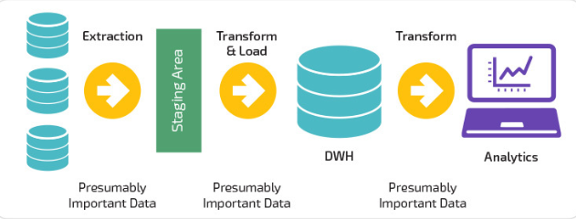
What is ETL?
Extraction, transformation, and loading is a process used to get raw data into a state that is easily accessible and useable.
Extraction
Extraction involves moving data from a database into a data transformation environment
Transformation
Transformation is the process used to prepare data for loading into a database
Loading
Loading takes transformed data and moves it into a data warehouse or data lake
Notes:
This process can be demanding and may require larger amounts of resources as the volume of data increases.
More storage space
Man hours for ETL maintenance
-Transformation:
Systems require data to be in a certain form, the transformation step of ETL prepares that data for the target system
-Loading:
Loaded data may or may not be normalized based on business requirements
Data is usually extracted from a database into pandas, R, or other data manipulation environment
Several examples of 3rd party ETL processes are:
Informatic PowerCenter
Azure
Apache Camel/Kafka

Slide 5


What is ETL: Storage Solutions
What is MySQL
Why do I need it?
How is it different from Oracle?
What is MongoDB
Why do I need it?
Notes:
MySQL is a free open-source relational database management system initially released in 1995.

Slide 6


What is ETL: Pandas & NVIDIA RAPIDS
Several packages exist for data manipulation and transformation, but for this project we will focus on python packages:
Pandas
This python package is designed for data manipulation
One of the most popular data manipulation packages in use
NVIDIA RAPIDS (cuDF)
NVIDIA RAPIDS is an open source suite of GPU optimized data manipulation, visualization, and machine learning libraries
cuDF is the GPU analog of pandas
Takes advantage of GPU parallelism and dedicated high bandwidth GPU memory
Syntax is nearly identical to pandas
Requires a NVIDIA Pascal+ GPU
Notes:
Pandas’ inbuilt functions that allow for data to quickly be cleaned, modified, and analyzed
- Used in a python environment
Common data manipulation tool like
Dplyr
Open source Python data manipulation library
Contains many inbuilt functions
Allows users to take advantage of a GPU’s thread count and high bandwidth dedicated memory
cuDF is a data manipulation library
NVIDIA RAPIDS is an open-source suite of data manipulation and machine learning libraries
Optimized for use with GPUs
Syntax is nearly identical to Pandas

Slide 7





Hypotheses
We expect MySQL to take longer in read/write operations compared to NoSQL
Transformations may take longer in NoSQL as there is a potential for duplicate data
cuDF will outperform Pandas in data transformation
Notes:
Since the data is normalized, in MySQL we expect the transformation process to work faster than in NoSQL.
Modification of data in MySQL will occur in one location (a tabular relational database) for normalized data
Modification of data in NoSQL requires referencing multiple documents
However, the read write process would take more time in MySQL than NoSQL due to:
ACID compliant properties required in relational databases.
Note about cuDF
note

Slide 8
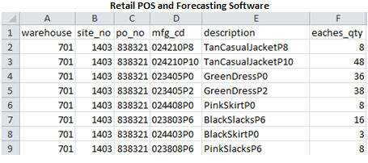
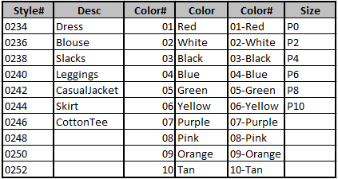
Experiment Set-up : Data
Kelly-Moore Paints Company provided data for this analysis
Transform 406 paint SKUs from paint to 406 SKUs for a women's boutique clothing line
The schema used is a combination of article type, color and size
Proprietary information was removed from the dataset
Reannan put blurbs HERE
Notes:
Kelly-Moore Paints data pulled from data warehouse
Data needed to be reverse engineered into it’s normal form
This is done to test extraction and transformation phases of ETL
The data is generated from 2 sources
Retail Point of Sale
Forecasting software
The data is comprised of:
Order recommendations – at the site level
Actual sales – at the site level

Slide 9
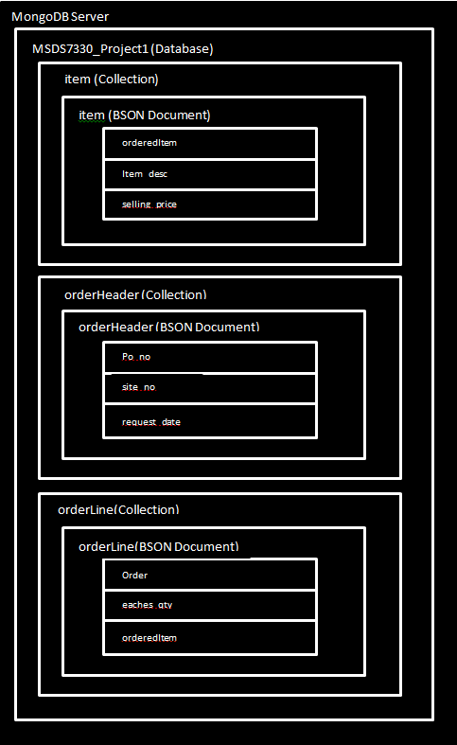
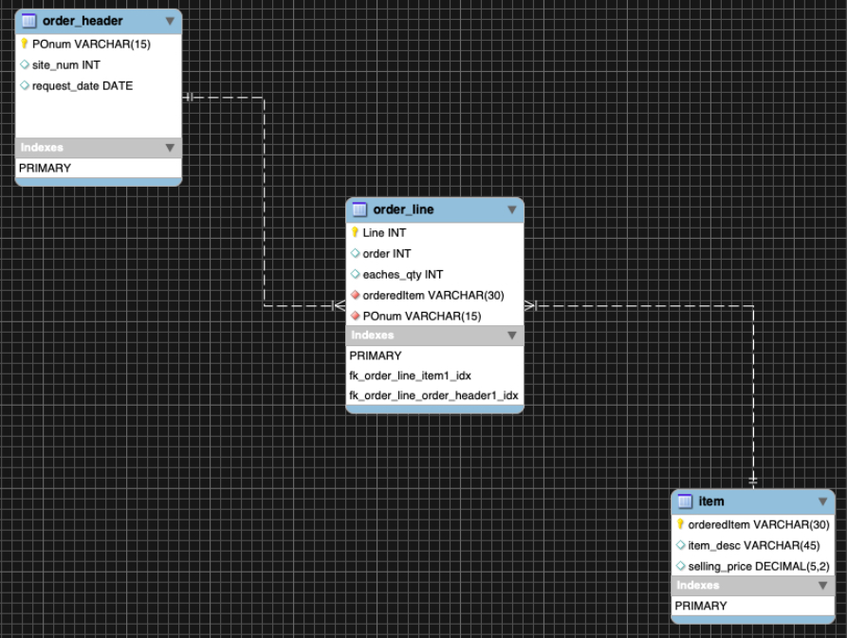
Experiment Set-up: Database Models
MongoDB
MYSQL
Notes:
Data is in the process of normalization

Slide 10
Experiment set-up: Software
OS and Transformation
Extraction and Loading
Ubuntu 18.04 LTS
MongoDB 4.2
MongoDB Compass 1.20.5
MySQL 8.0.19
MySQL Workbench 8.0.19
Python 3.7.0
Jupyter Notebook 6.0.3
Pandas 1.0.3
cuDF 0.8
Cuda Toolkit 10.2
Rstudio 1.2.5033
R 3.6.3
Software Open During ETL
2 Internet Browser Tabs
DB Application
Excel
Zoom
File Explorer

Slide 11
Experiment set-up: Hardware
AMD Ryzen 9 3900X
32GB RAM
NVIDIA 2070 Super
500GB NVME m.2 SSD

Slide 12
Experiment Methodology
Measuring ETL Performance
Performance metrics such as: CPU usage, RAM usage, and time to execute operations will be captured
Metrics will be captured at the following points in the ETL process:
Reading in data from database
Execution of transformation code
Loading of data into data warehouse
Notes:
We expect the execution of transformation and loading of data to be the slowest portion of the ETL process
This is because:
Depending on complexity, transformation may require more computational resources
Writing data to storage is a slow process

Slide 13
Experiment Methodology: Treatments
Light ETL
Items table extracted to Jupyter Notebook (400 rows) from MySQL and MongoDB
Clothing items with “Blue” in description were changed to “Navy” using Pandas and cuDF
Transformed data was then loaded into MySQL and MongoDB
Medium ETL
Order_line and item tables were joined in MySQL then extracted to Jupyter Notebook (240k+ rows)
For MongoDB extraction, tables were pulled separately then joined in Juypter Notebook
Clothing items with “Blue” in description were changed to “Navy” using Pandas and cuDF. A calculated column for price and quantity was also created
Data was then loaded into MySQL and MongoDB
Heavy ETL
Order_header, order_line, item tables were joined in MySQL then extracted to Jupyter Notebook (240k+ rows)
For MongoDB extraction, tables were pulled separately then joined in Juypter Notebook
Clothing items with “Blue” in description were changed to “Navy” using Pandas and cuDF. A calculated column for price and quantity was also created
Data was then loaded into MySQL and MongoDB

Slide 14
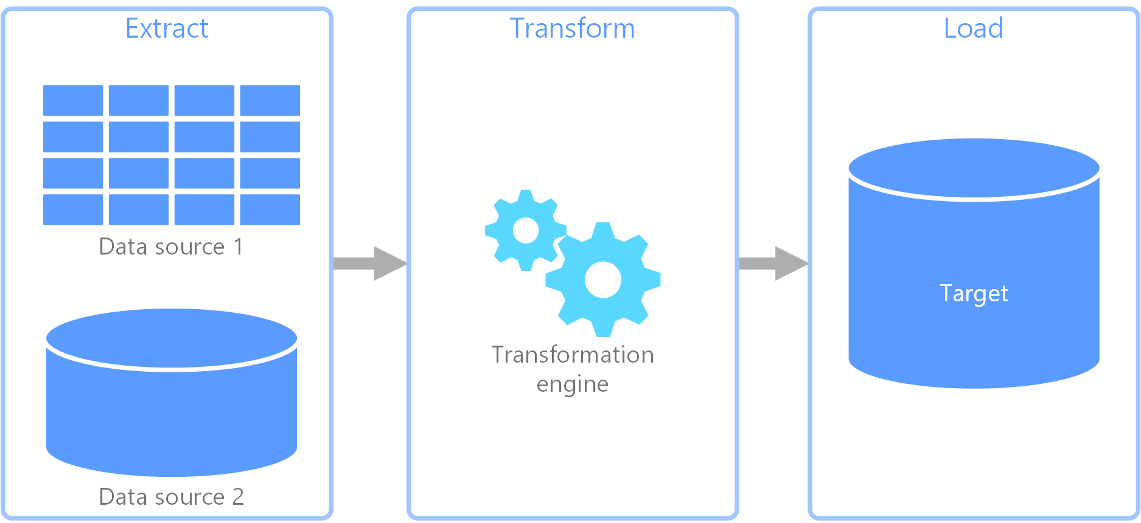
Experiment Methodology: Data capture
x 6 = 720
(
n = 30
+
n = 60
+
n = 30
)
A for loop was used to iterate through each ETL process with a 5 second break between samples to allow for the system to return to base utilization.
i.e. for the “Light ETL” 30 samples were captured for extraction, 60 samples for transformation (pandas and cuDF), and 30 for loading
CPU and RAM base utilization were captured before process execution
CPU and RAM levels are sampled immediately after process is completed
Sample CPU and RAM utilizations were subtracted from base utilization to derive utilization due to ETL processes
Notes:
30 samples were captured for each extraction and loading step, and 60 samples were collected for each transformation step – one set of 30 for for a total of 720 samples.
Photo cred: https://docs.microsoft.com/en-us/azure/architecture/data-guide/relational-data/etl

Slide 15
Experiment Execution: Problems encountered?
Working with Databases
Granting write privileges in MySQL
Setting buffer length and packet sizes in MySQL
Normalizing Data in MySQL
Transferring data to and from databases
Installing Drivers for cuDF use
Notes:
MySQL – there are requirements for granting script privileges.
Connecting MySQL in Jupyter
MySQL – there are requirements for granting script privileges.
Specify buffer lengths (time database has to weight) and allow packet sizes (batch size, how much data db can take at one time).
Connecting MongoDB in Jupyter
Simple process within Jupyter

Slide 16
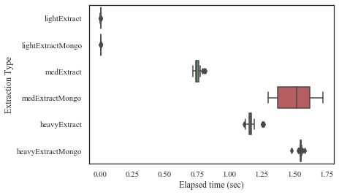
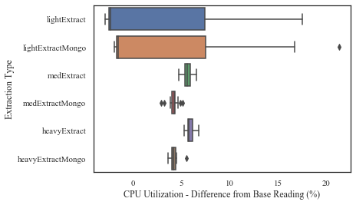
Results: Extraction
Extracting from MySQL could be faster than MongoDB
Elapsed time suggest MySQL is faster than MongoDB for medium and heavy workloads
This comes at the expense of CPU utilization
CPU utilization is higher for MySQL for both medium and heavy workloads
Notes:
After covering this slide read the following:
“For implementation the following database types and manipulation library are being used for this project”

Slide 17
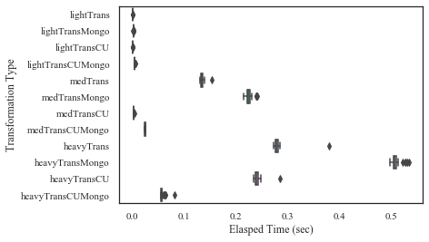
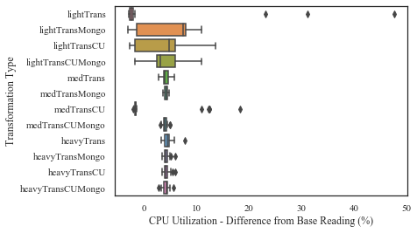
Results: Transformation
cuDF shows significantly faster transformations for some work loads
For medium and heavy workloads cuDF out preforms pandas by a large margin
This holds true regardless of extraction database
Database type appears to have an impact on transformation durations
For medium and heavy workloads MySQL extractions allows for faster transformations
This may be due to strict enforcement of data types during schema design
Notes:
Ensure data is normalized
Ideal for relational data
Requires normalization of data for efficient operation
Utilizes Structured Query Language

Slide 18
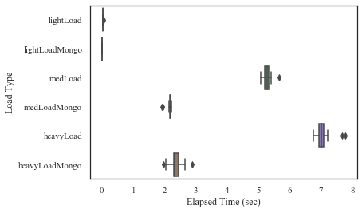
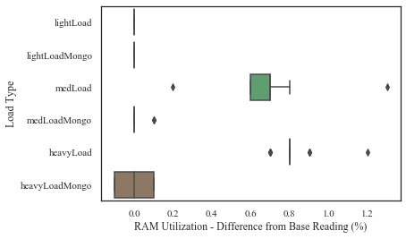
Results: Loading
MongoDB is significantly faster for loading Data
For medium and heavy workloads MongoDB out preforms MySQL by a large margin
For medium and heavy workloads MongoDB also uses less RAM resources than MySQL
Notes:
An alternative database for the extraction/loading phases is MySQL
Is a database solution that typically models non-relational data
MongoDB and Apache Cassandra are examples
Does not require data to be normalized

Slide 19
Statistics

Slide 20
Conclusion

